Slide 1

Beamformer Tutorial
May 18, 2017
Enson Chang

Slide 2
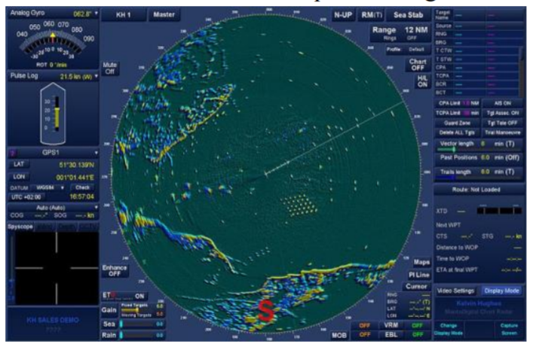
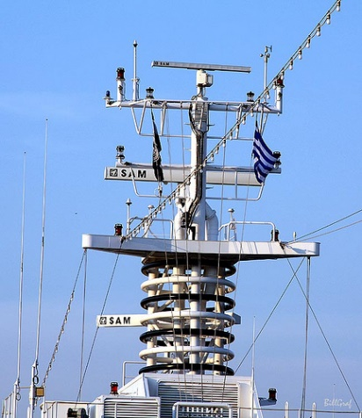
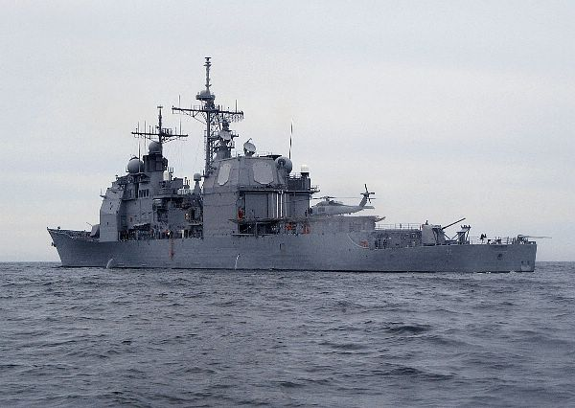
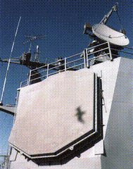

Slide 3
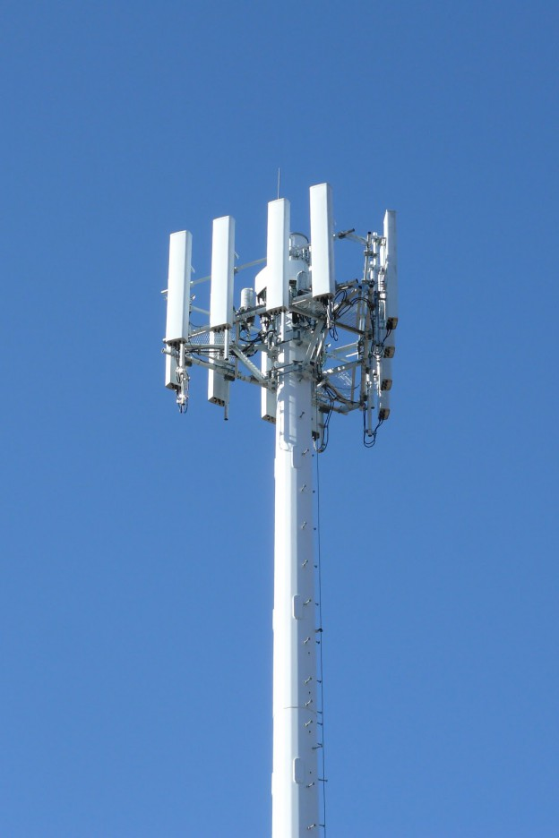
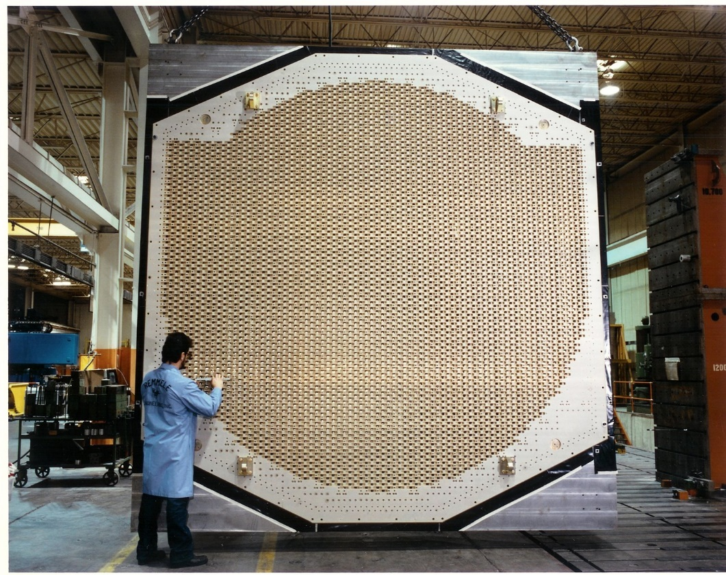

Slide 4
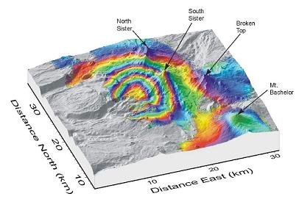
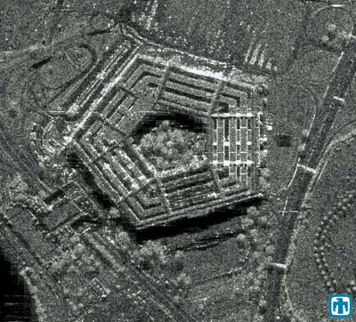
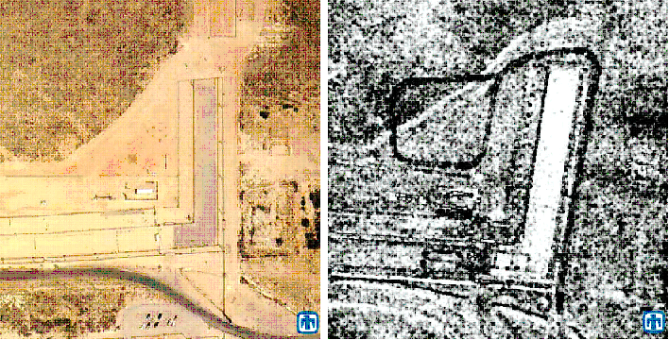
Examples of Phased Array Radar Imagery

Slide 5
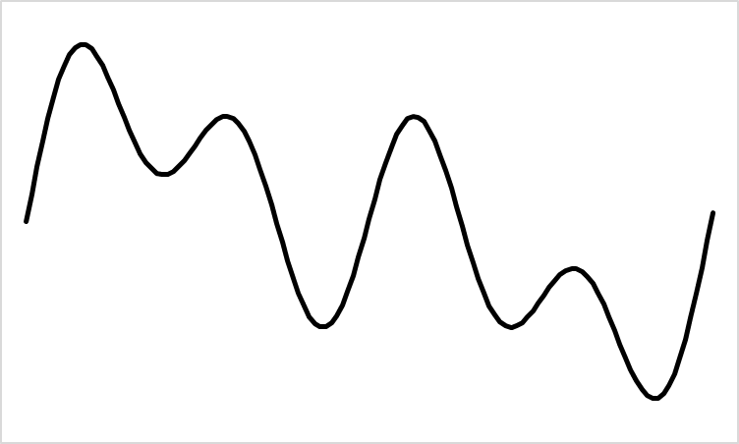








Beamformer Principle
Assume a distant source
Signal is essentially plane wave at the receivers
Signal at receivers are delayed versions of each other
Delay depends on incident direction and array spacing
$Δt=(d\sin{θ})/c$
$$θ$$
$$θ$$
$$d$$
$$0$$
$$1$$
$$2$$
. . .
$$N−1$$

Slide 6
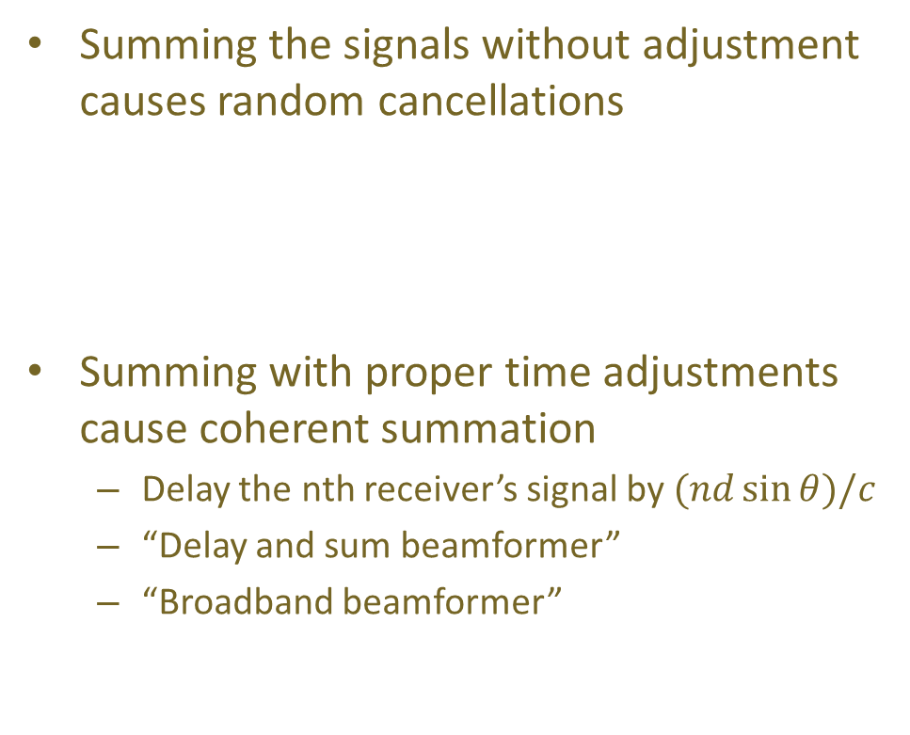


Beamformer Principle (cont’d)
Summing the signals without adjustment causes random cancellations
Summing with proper time adjustments cause coherent summation
Delay the nth receiver’s signal by $(nd\sin{θ})/c$
“Delay and sum beamformer”
“Broadband beamformer”
$$\sum_{n=0}^{N−1}{s_{n}(t)}$$
$$\sum_{n=0}^{N−1}{s_{n}(t−\frac{nd\sin{θ}}{c})}$$

Slide 7
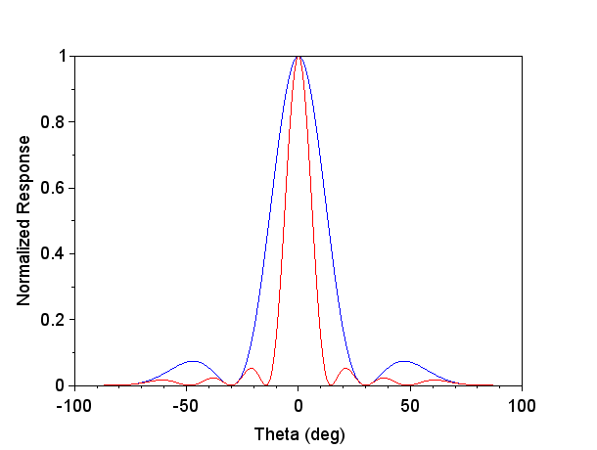

Why Beamform?
What do you gain?
Stronger signal: Signal to noise ratio (SNR) $\sim N$
A sharper beam: Beam width $\sim λ/(Nd)$
You can also transmit a sharp beam in a certain direction the same way
N = 4
N = 8

Slide 8
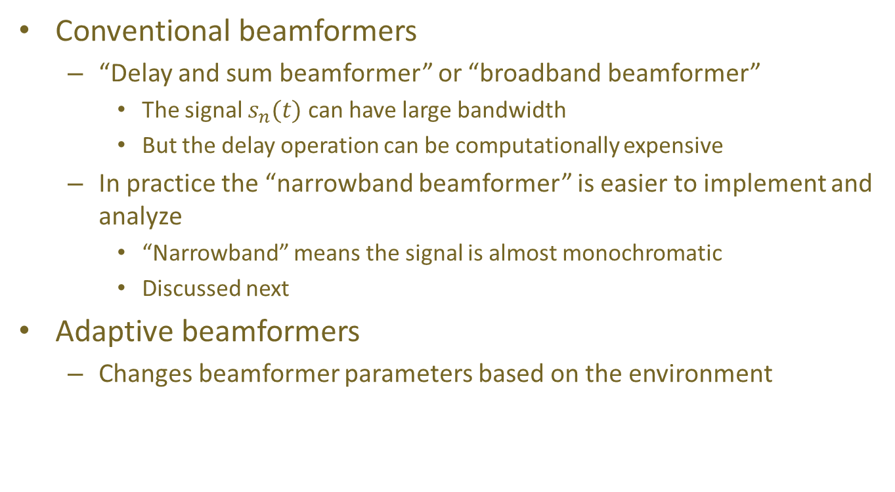
Types of Beamformers
Conventional beamformers
“Delay and sum beamformer” or “broadband beamformer”
The signal $s_{n}(t)$ can have large bandwidth
But the delay operation can be computationally expensive
In practice the “narrowband beamformer” is easier to implement and analyze
“Narrowband” means the signal is almost monochromatic
Discussed next
Adaptive beamformers
Changes beamformer parameters based on the environment

Slide 9
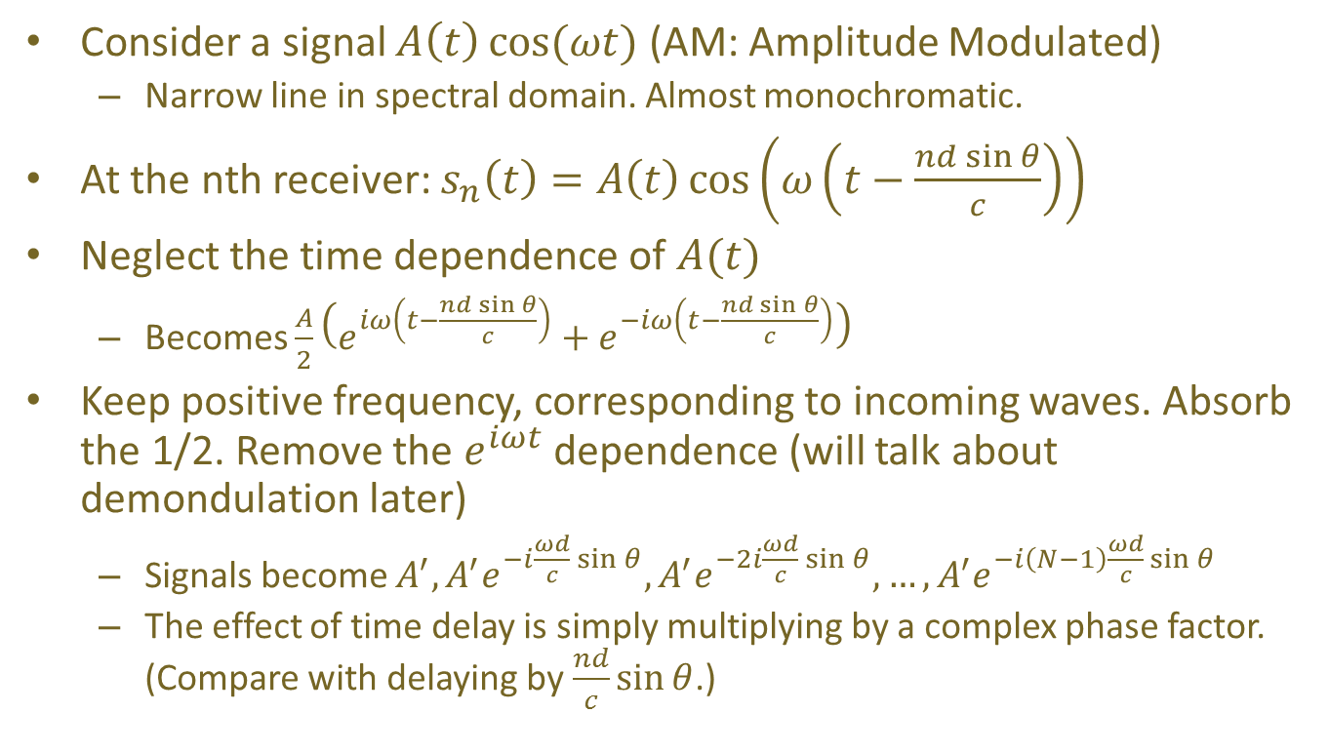
Narrowband Beamformer
Consider a signal $A\left(t\right)\cos{(ωt)}$ (AM: Amplitude Modulated)
Narrow line in spectral domain. Almost monochromatic.
At the nth receiver: $s_{n}\left(t\right)=A\left(t\right)\cos\left(ω\left(t−\frac{nd\sin{θ}}{c}\right)\right)$
Neglect the time dependence of $A(t)$
Becomes $\frac{A}{2}\left(e^{iω\left(t−\frac{nd\sin{θ}}{c}\right)}+e^{−iω\left(t−\frac{nd\sin{θ}}{c}\right)}\right)$
Keep positive frequency, corresponding to incoming waves. Absorb the 1/2. Remove the $e^{iωt}$ dependence (will talk about demondulation later)
Signals become $A^{′},A^{′}e^{−i\frac{ωd}{c}\sin{θ}},A^{′}e^{−2i\frac{ωd}{c}\sin{θ}},…,A^{′}e^{−i\left(N−1\right)\frac{ωd}{c}\sin{θ}}$
The effect of time delay is simply multiplying by a complex phase factor. (Compare with delaying by $\frac{nd}{c}\sin{θ}$.)

Slide 10
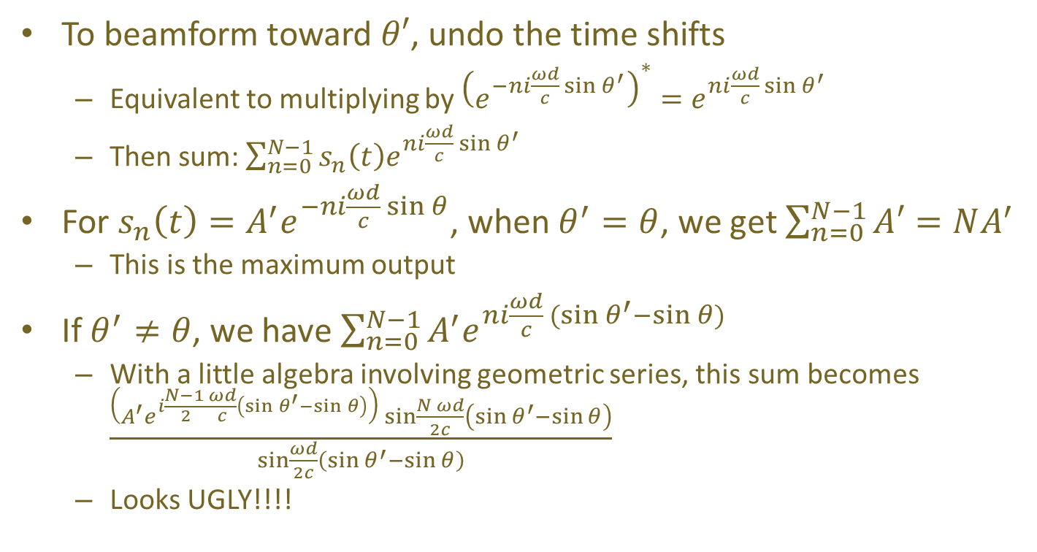
Narrowband Beamformer (cont’d)
To beamform toward $θ′$, undo the time shifts
Equivalent to multiplying by ${\left(e^{−ni\frac{ωd}{c}\sin{θ^{′}}}\right)}^{∗}=e^{ni\frac{ωd}{c}\sin{θ^{′}}}$
Then sum: $\sum_{n=0}^{N−1}{s_{n}\left(t\right)e^{ni\frac{ωd}{c}\sin{θ^{′}}}}$
For $s_{n}\left(t\right)=A^{′}e^{−ni\frac{ωd}{c}\sin{θ}}$, when $θ^{′}=θ$, we get $\sum_{n=0}^{N−1}{A′}=NA^{′}$
This is the maximum output
If $θ^{′}≠θ$, we have $\sum_{n=0}^{N−1}{A^{′}e^{ni\frac{ωd}{c}(sin{θ^{′}−\sin{θ})}}}$
With a little algebra involving geometric series, this sum becomes $\frac{\left(A^{′}e^{i\frac{N−1 }{2}\frac{ωd}{c}\left(\sin{θ^{′}}−\sin{θ}\right)}\right)\sin{\frac{N ωd}{2c}\left(\sin{θ^{′}}−\sin{θ}\right)}}{\sin{\frac{ωd}{2c}\left(\sin{θ^{′}}−\sin{θ}\right)}}$
Looks UGLY!!!!

Slide 11
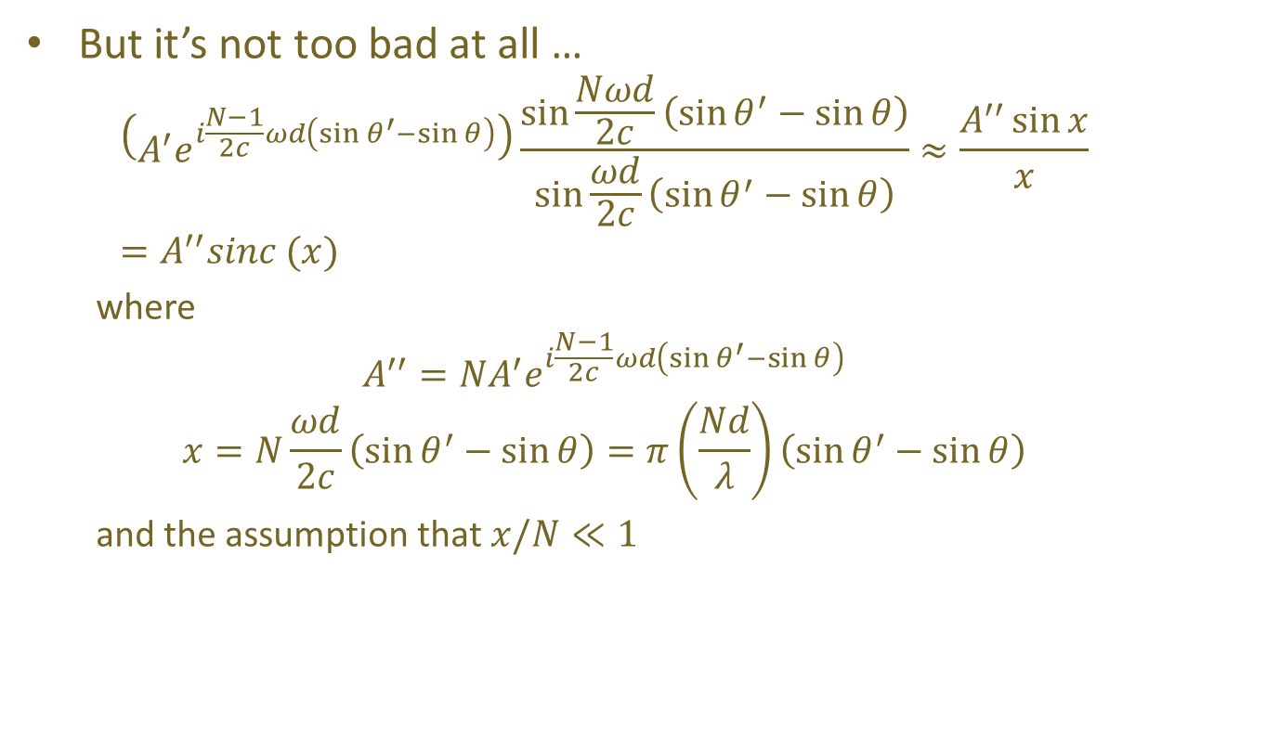
Narrowband Beamformer Response
But it’s not too bad at all …
$$\left(A^{′}e^{i\frac{N−1}{2c}ωd\left(\sin{θ^{′}}−\sin{θ}\right)}\right)\frac{\sin{\frac{Nωd}{2c}\left(\sin{θ^{′}}−\sin{θ}\right)}}{\sin{\frac{ωd}{2c}\left(\sin{θ^{′}}−\sin{θ}\right)}}≈\frac{A^{′′}\sin{x}}{x}=A^{′′}sinc (x)$$
where
$$A^{′′}={NA}^{′}e^{i\frac{N−1}{2c}ωd\left(\sin{θ^{′}}−\sin{θ}\right)}$$
$$x=N\frac{ωd}{2c}\left(\sin{θ^{′}}−\sin{θ}\right)=π\left(\frac{Nd}{λ}\right)\left(\sin{θ^{′}}−\sin{θ}\right)$$
and the assumption that $x/N≪1$

Slide 12
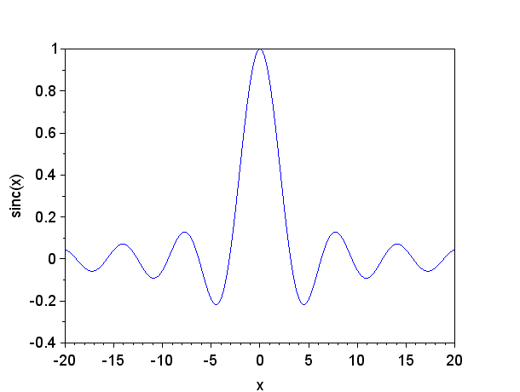
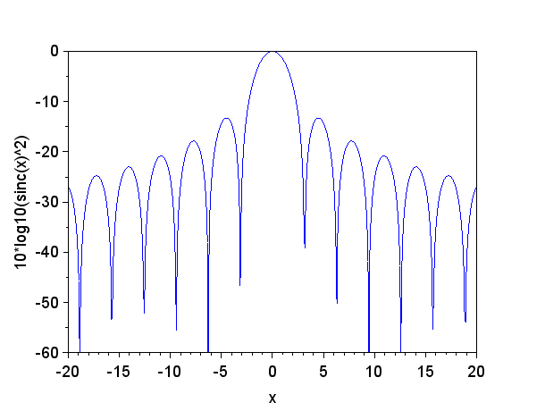

Beamformer Response (cont’d)
Explain: Dependence on $Nd/λ$
Explain: Response, dB scale, -3 dB width, sidelobes

